Slide 1
heap

Slide 2
What is Heap?
Heap is a special case of balanced binary tree data structure where the root-node key is compared with its children and arranged accordingly
A Heap is a special Tree-based data structure in which the tree is a complete binary tree
Heaps are often used to implement priority queues, where the smallest (or largest) element is always at the root of the tree.
Notes:
Insert a map of your country.

Slide 3
What is a complete binary tree?
A complete binary tree is a binary tree in which all the levels except the last level, i.e., leaf node should be completely filled, and all the nodes should be left-justified
In the last level, all the nodes must be as left as possible.
In a complete binary tree, the nodes should be added from the left.
Notes:
Insert a map of your country.

Slide 4
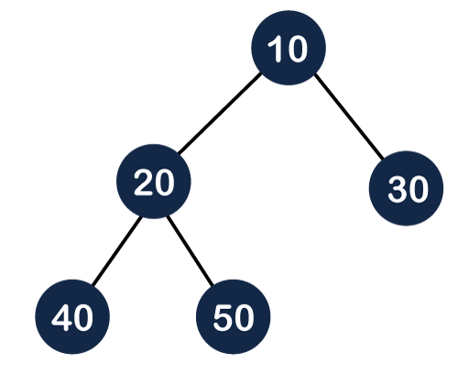
Example of complete binary tree
all the internal nodes are completely filled except the leaf node;
Notes:
Insert a map of your country.

Slide 5
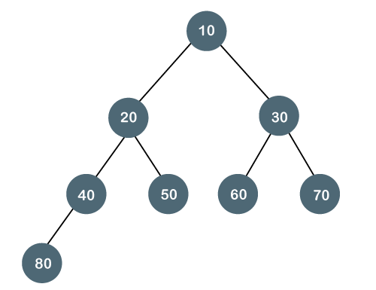
Example of complete binary tree
all the nodes are completely filled, and all the nodes in the last level are added at the left first.
Notes:
Insert a map of your country.

Slide 6
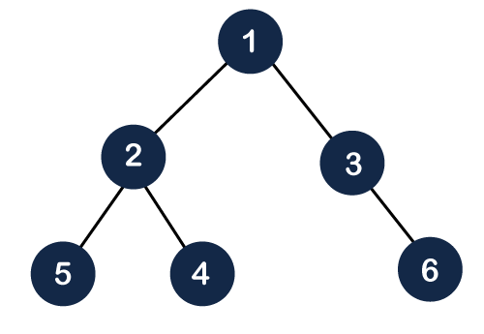
all the internal nodes are completely filled except the leaf node, but the leaf nodes are added at the right part;
It is not complete binary tree
Notes:
Insert a map of your country.

Slide 7
How can we arrange the nodes in the Tree?
There are two types of the heap:
Min Heap
Max heap
Notes:
Insert a map of your country.

Slide 8
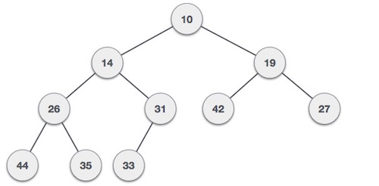
Min Heap: The value of the parent node should be less than or equal to either of its children.
Notes:
Insert a map of your country.

Slide 9
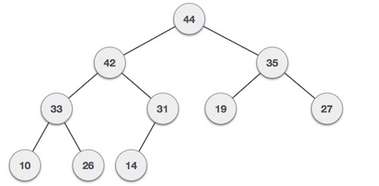
Max-Heap − Where the value of the root node is greater than or equal to either of its children.
Notes:
Insert a map of your country.

Slide 10
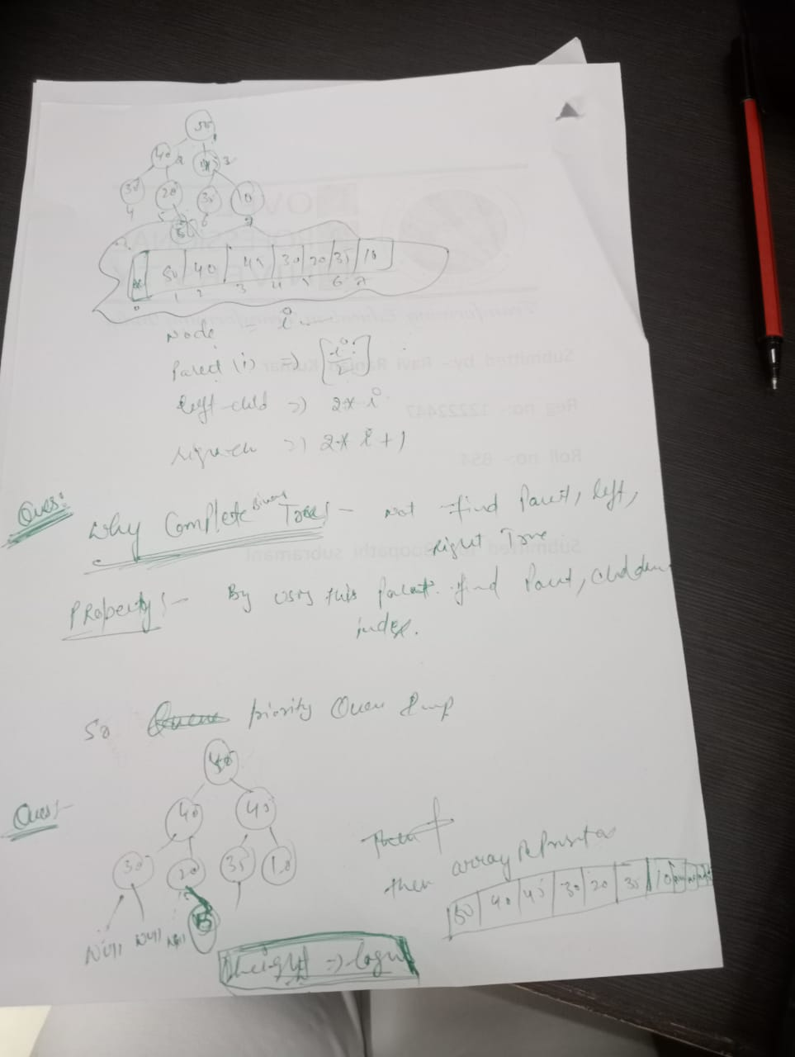

Slide 11
Max Heap Construction Algorithm
44, 33, 77, 11, 55, 88, 66
To create the max heap tree, we need to consider the following two cases:
First, we have to insert the element in such a way that the property of the complete binary tree must be maintained.
Secondly, the value of the parent node should be greater than the either of its child.
Notes:
Insert a map of your country.

Slide 12
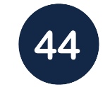
First we add the 44 element in the tree as shown below:
Notes:
Insert a map of your country.

Slide 13
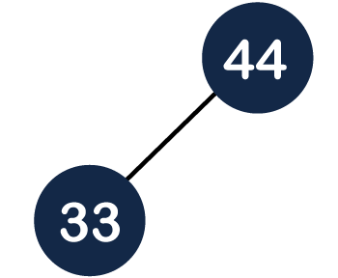
The next element is 33. As we know that insertion in the binary tree always starts from the left side so 44 will be added at the left of 33 as shown below
Notes:
Insert a map of your country.

Slide 14
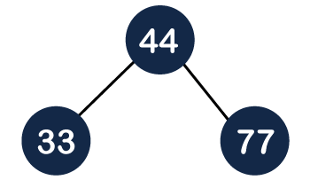
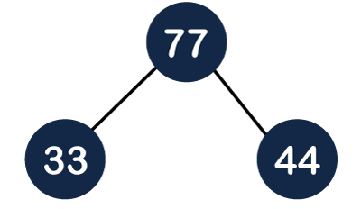
The next element is 77 and it will be added to the right of the 44 :
it does not satisfy the max heap property, i.e., parent node 44 is less than the child 77. So, we will swap these two values
Notes:
Insert a map of your country.

Slide 15
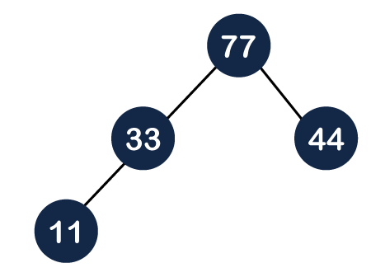
The next element is 11. The node 11 is added to the left of 33
Notes:
Insert a map of your country.

Slide 16

The next element is 55. To make it a complete binary tree, we will add the node 55 to the right of 33
it does not satisfy the property of the max heap because 33<55, so we will swap these two values
Notes:
Insert a map of your country.

Slide 17

Notes:
Insert a map of your country.

Slide 18
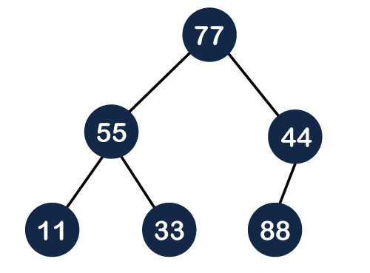
The next element is 88. The left subtree is completed so we will add 88 to the left of 44
Notes:
Insert a map of your country.

Slide 19
it does not satisfy the property of the max heap because 44<88, so we will swap these two values
Again, it is violating the max heap property because 88>77 so we will swap these two values as shown
Notes:
Insert a map of your country.

Slide 20
The next element is 66. To make a complete binary tree, we will add the 66 element to the right side of 77
Notes:
Insert a map of your country.

Slide 21
Step 1 − Create a new node at the end of heap.
Step 2 − Assign new value to the node.
Step 3 − Compare the value of this child node with its parent.
Step 4 − If value of parent is less than child, then swap them.
Step 5 − Repeat step 3 & 4 until Heap property holds.
Notes:
Insert a map of your country.

Slide 22
Max Heap construction
35 33 42 10 14 19 27 44 26 31
Notes:
Insert a map of your country.

Slide 23
Create binary max-heap implemented using an array .Which one of the following array represents binary max-heap ?
25 ,12 , 16 , 13 ,10, 8 , 14
25 ,14 , 13 ,16 , 10 ,8, 12
25 , 14 ,16 ,13 , 10 ,8 ,12
25 ,14 ,12 ,13 , 10 , 8 , 16
What is the content of array after 2 delete operations on correct answer of above question ?
14 ,13, 12, 10 ,8
14 ,12, 13 ,8 ,10
14 ,13 ,8,12 ,10
14 ,13 ,12 , 8 ,10

Slide 24
Ques : 50 30 40 10 5 20 30 insert 60
void insert(array , n,item )
{
n=n+1
a[n]=item
for(i=n;i>1;i=i/2)
{
int parent =i/2;
if(a[parent]<a[i])
{
swap(parent , child)
i=parent ;
}
else {
exit
} }
}

Slide 25
COMPELXITY
Time Complexity depends upon height of tree .
Height of complete binary tree : logn (becz compeltey filled and height is reduced ).
So insert 1 elemnt logn (how many swap and comparison )
Logn + logn =logn
So insert n elemnt logn (how many swap and comparison )
nlogn

Slide 26
Max Heap Deletion Algorithm
Deletion in Max (or Min) Heap always happens at the root to remove the Maximum (or minimum) value.
In Deletion in the heap tree, the root node is always deleted and it is replaced with the last element.
Notes:
Insert a map of your country.

Slide 27
The standard deletion operation on Heap is to delete the element present at the root node of the Heap.
That is if it is a Max Heap, the standard deletion operation will delete the maximum element and if it is a Min heap, it will delete the minimum element.
Notes:
Insert a map of your country.

Slide 28
steps
Step 1 − Remove root node.
Step 2 − Move the last element of last level to root.
Step 3 − Compare the value of this child node with its parent.
Step 4 − If value of parent is less than child, then swap them.
Step 5 − Repeat step 3 & 4 until Heap property holds.
Notes:
Insert a map of your country.

Slide 29
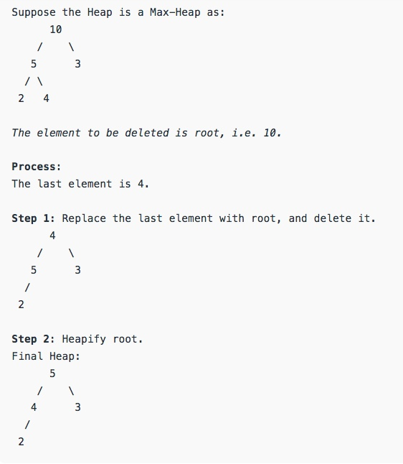
Notes:
Insert a map of your country.

Slide 30
Notes:
Insert a map of your country.

Slide 31
Create binary max-heap implemented using an array .Which one of the following array represents binary max-heap ?
25 ,12 , 16 , 13 ,10, 8 , 14
25 ,14 , 13 ,16 , 10 ,8, 12
25 , 14 ,16 ,13 , 10 ,8 ,12
25 ,14 ,12 ,13 , 10 , 8 , 16
What is the content of array after 2 delete operations on correct answer of above question ?
14 ,13, 12, 10 ,8
14 ,12, 13 ,8 ,10
14 ,13 ,8,12 ,10
14 ,13 ,12 , 8 ,10

Slide 32
void delete(array ,n )
{
a[1]= a[n]
n=n-1
i=1;

Slide 33
while(i<n)
{
int left =a[2*i]
int right = a[2*i+1]
int larger =left>right ? 2*i :2*i+1;
if(a[i]<a[larger])
{
swap(a[i],larger)
i= larger
}
else
{
return
}
}
}

Slide 34
heapify method
20 10 30 5 50 40

Slide 35
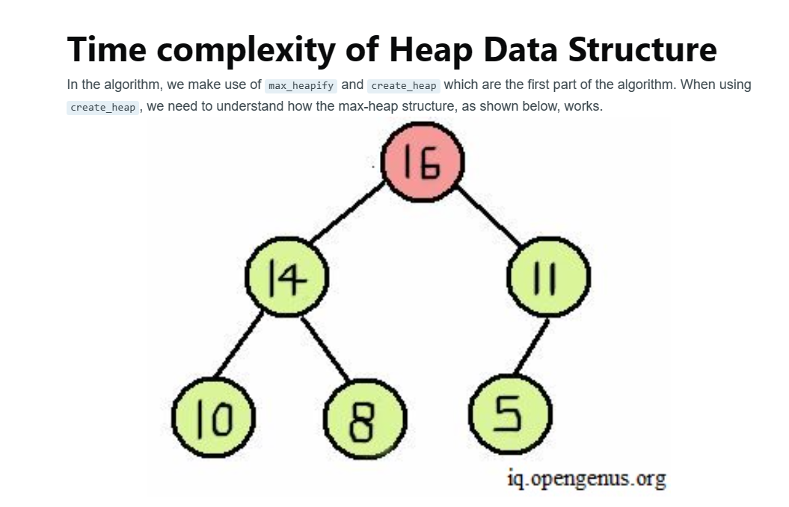
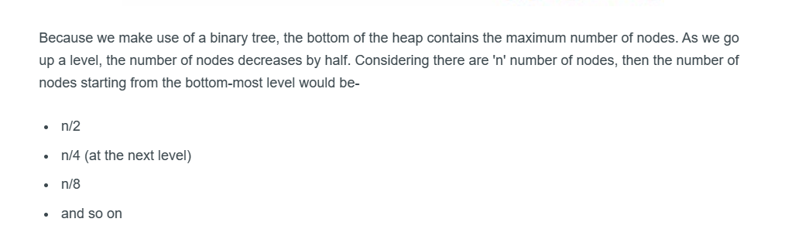

Slide 36
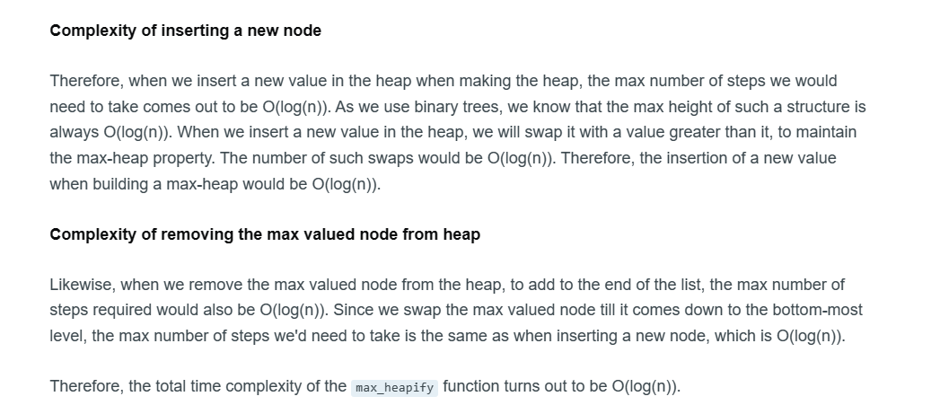

Slide 37
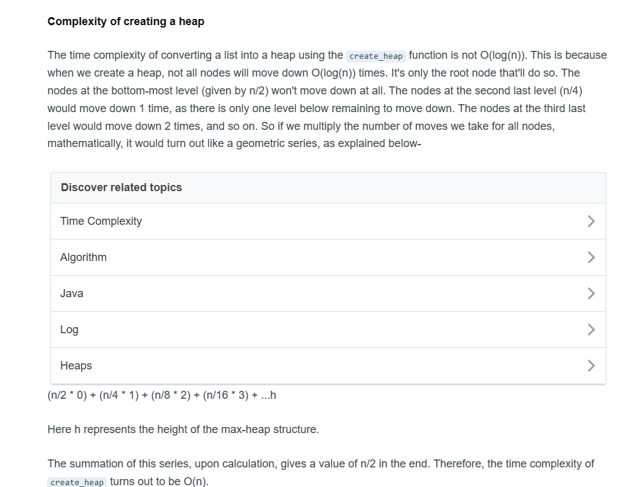

Slide 38
Insertion 2nd method (heapify method )
20 10 30 5 50 40

Slide 39
Insertion 2nd method (heapify method )
COMPLEXITY insert n elents : O(n)
Derivation gp series
Find Last leaf node index : n/2
Find from where leaf nodes start(index): n/2+1
We perform operation from n/2 nodes.

Slide 40
20 10 30 5 50 40
HEAPYY METHOD
We perform operation from n/2 nodes
Operation strts from n/2 i.e. 20 10 30 and other are leaf nodes so ignore no operation
But in fist method perform operation on all nodes.

Slide 41
ALGORITHM
Same above but for loop starts from n/2
for(i=n/2 ;i>1;i=i/2) [no need to perform operation on leaf nodes ]

Slide 42
Ques : 50 30 40 10 5 20 30 insert 60 uisng heapify method
void insert(array , n,item )
{
n=n+1
a[n]=item
for(i=n/2;i>1;i=i/2)
{
int parent =i/2;
if(a[parent]<a[i])
{
swap(parent , child)
i=parent ;
}
else {
exit
} }
}

Slide 43
Applications of Heap Data Structure
Priority Queues
Heap sort
Order statistics: The Heap data structure can be used to efficiently find the kth smallest (or largest) element in an array
Notes:
Insert a map of your country.

Slide 44
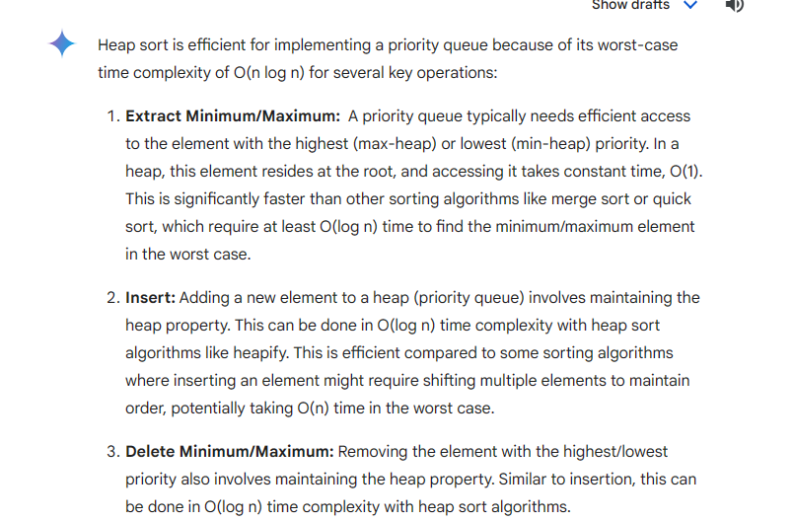

Slide 45
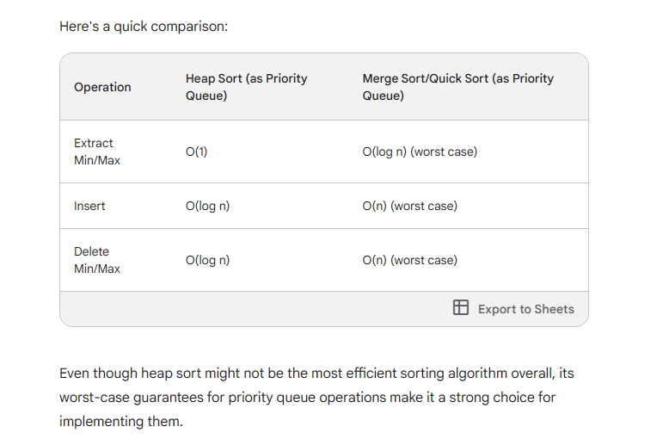

Slide 46
HEAP SORT
ARRAY ELEMNTS GIVEN : 20 10 30 5 50 40
STEPS :
construct tree using heapify method .
Convert into max heap (swapping opertion perform)
Perform deletion operation (same as heap )root element remove and store in other array & replace root with last leaf node.Perform this steps n times

Slide 47
100 10 90 15 50 40

Slide 48
Priority Queues
QUEUE PPT

